Slide 1
College List Planning

Slide 2
Discussion Questions
Have you thought about some colleges that you might want to attend?
Write down a list of colleges that you would be interested in attending.
Keep that list with you and think about it as we continue the workshop.

Slide 3
What should you keep in mind when making your college list?
Notes:
Discuss with students

Slide 4
Ideal College
Does anyone have a college on their list that they consider to be the best college that they can ever go to?
Pick one school and write next to it the biggest reason you want to go there.

Slide 5
Ideal College
Why is this my ideal college?
Will this really benefit me in the long run?
What are the pros of going there? What are the cons?
What is more important going to the ideal college or getting that degree?

Slide 6
Researching a College
Visit their website
Be careful when looking through directories. Many websites or databases are not updated every year.
Visit a college search website (https://www.cappex.com/colleges)
Visit the campus (if you can)
Talk to an Alumni (one person’s experience might not be your own)
Visit their social media pages

Slide 7
Programs/Majors
Write one major or profession that you are really considering.
(It’s fine if you don’t know yet.)

Slide 8
Programs/Majors
What are you interested in?
What are the core requirements listed on the website? (First year you can focus on doing core requirements courses that aligns with possible major if unsure)
If you already have a major in mind, does this college offer it and does it have a good program?

Slide 9
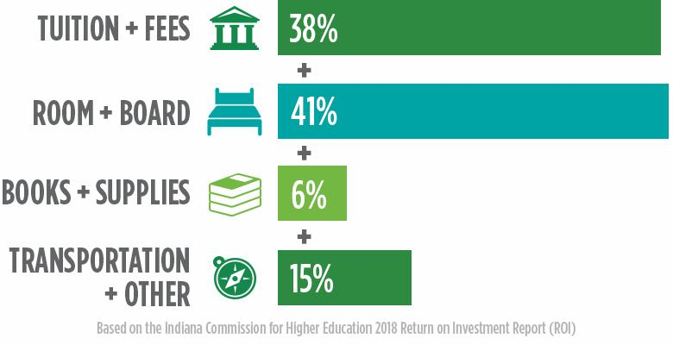
Cost
How much financial aid can you get for this college?
Is it a 100% need met school?
What scholarships can you apply for?
How much loans could you end up with if you don’t get enough financial aid or scholarships?

Slide 10
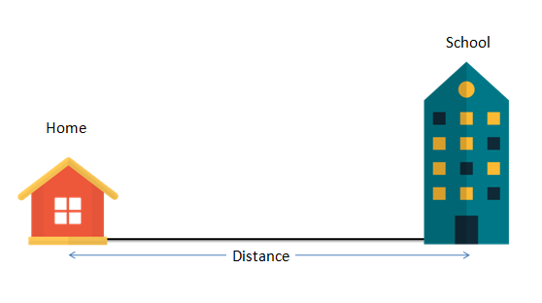
Distance/Location
Do you want to stay home or live on campus?
Think about the pros and cons of each
For example: Staying home might allow you to save money on housing and other expenses. (Depending on your living situation)
Will you be able to commute if you stay home?
Staying at home might not be an option at all depending on living situation.

Slide 11
Size/Demographic
Do you feel like you will fit in at your ideal college?

Slide 12
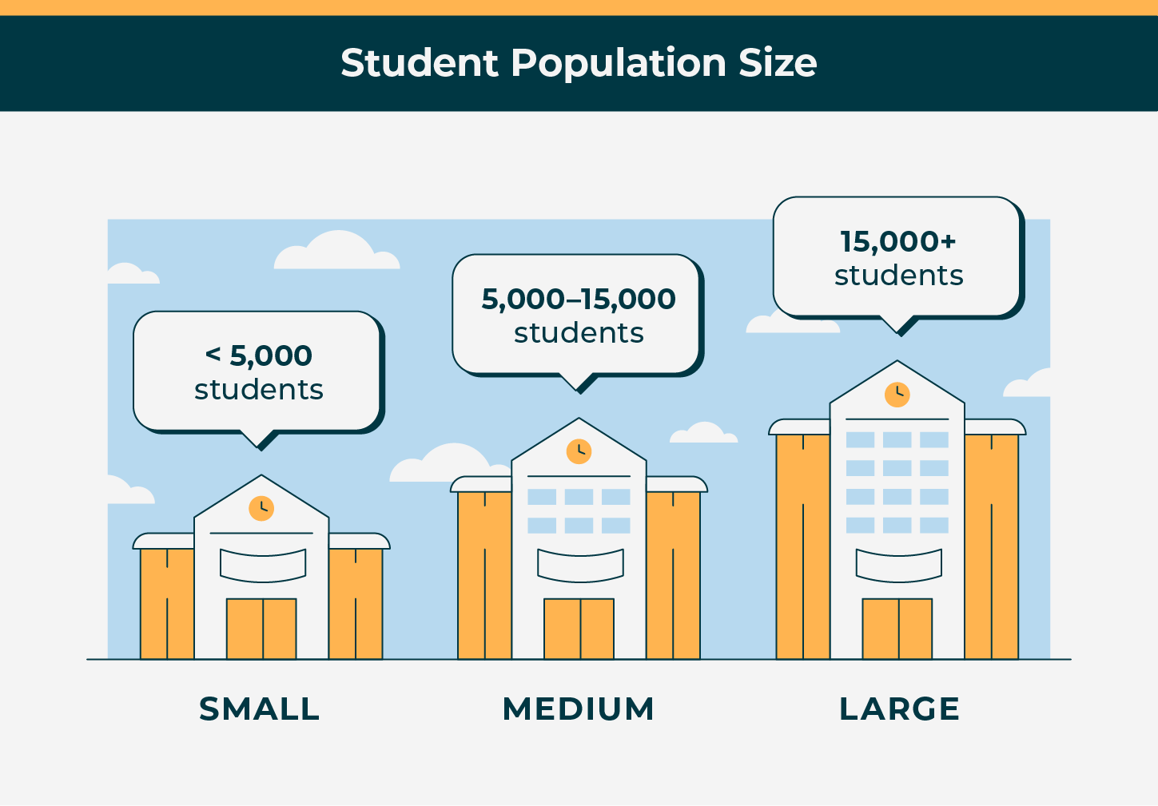

Slide 13
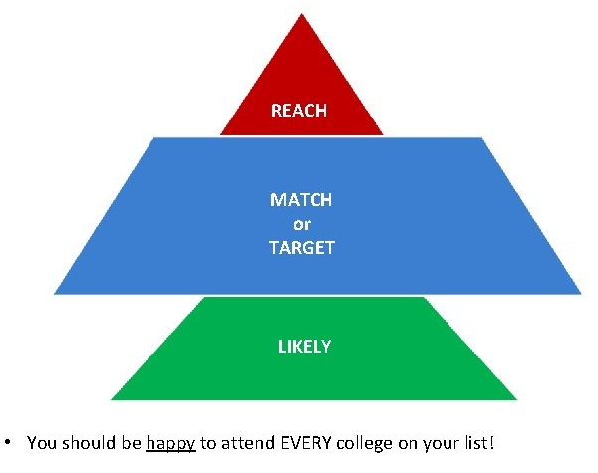
Build your list

Slide 14
Conclusion: How to make a college list?
Start early so that you have enough time to do your research
Think about the cost, the financial aid, the programs offered, the opportunities offered, and the campus dynamic
Think about the pros and cons of graduating from this college
Ask for questions and do not be afraid to reach out to people that want to support you in this process.
Keep an open-mind.
BEAM is always available to help
Hector Contact Info: hector@beammath.org (347) 594-5730 Ext. 997

Slide 15
Any Questions?

