Slide 1
Financial Aid
Notes:
What is one thing that scares you about the Financial Aid process?
Handing out the correct doc, not miss anything
If I am able to get financial aid
Qualifications
Deadlines
Being Unable to attend because of finances
Everything is correct
What is one thing you are looking forward to learn about today?

Slide 2
Overview

Slide 3
CSS Profile
FAFSA
TAP
Colleges
Gov’t

Slide 4
FAFSA
Free
Qualifies you for gov’t money that you are entitled to
But many colleges also use it to figure out if they want to give you money
Must send in taxes for the parents you live with
Uses “prior-prior year” – so for 12th graders, 2021
Easiest to import directly from IRS
Have been asking for verification more often
Notes:
We can keep login info

Slide 5
FAFSA cont’d
VERY IMPORTANT: Keep login info!!!!!!!!
Put CUNY or SUNY first in college list, for complicated reasons
You can only list 10 colleges at a time, but you can go back to the FAFSA a week later to include any remaining schools
Undocumented students: can print and fill out paper copy to give colleges, but don’t submit
Doesn’t let you list special circumstances
Must refile every year of college!
Notes:
We can keep login info

Slide 6
CSS Profile
Has fee – often waived though (if you qualify for testing fee waiver it will trigger immediately)
Used by private colleges to determine “need”
Uses “Prior-prior year” taxes and forecasted income
Must file every year (if your college uses it)
Undocumented students can use
Very long & and asks for more detailed financial information (i.e. assets, savings, etc.)
If parents are separated or divorced, need info from both
Can list special circumstances

Slide 7
Common mistake alert!
Make sure your CSS Profile is complete by deadline!
(best if finished by mid December)

Slide 8
CSS Profile
FAFSA
TAP
Colleges
Gov’t
Expected Family Contribution
Notes:
Lots of ways to calculate EFC. Split among multiple students if other family members going to college.

Slide 9
What you pay…
EFC = Expected Family Contribution
COA = Cost of Attendance
Tuition
Housing
Food
Books
Travel
Personal Expenses
Need = COA - EFC
Notes:
What goes into COA?

Slide 10
Your Aid Offer
Grants
Loans
Work-Study
Notes:
What each is, benefits/drawbacks

Slide 11
Grants
Free money!!
Types:
Federal – yours no matter where you go to college
Pell Grants (up to $6,795 in 2021-2022)
FSEOG (limited by college, up to $4,000)
State
TAP (NYS only, up to $5,165 for tuition)
From college
Sometimes has strings attached
Notes:
FSEOG: Federal Supplemental Educational Opportunity Grant

Slide 12
Loans
Have to pay this back
Every year you don’t pay it back, you have to pay a little bit more (interest)
For example, I borrow 1000 with an interest rate of 10% and don’t pay it back:
the first year I’ll owe 1100 = 1000 + 10% of 1000
the second year I’ll owe 1210 = 1100 + 10% of 1100
the third year I’ll owe 1331 (and so on)
Notes:
PLUS loans are not as good.

Slide 13
Loans
Stafford Loans/Direct Loans (up to $5,500)
From the federal government
Subsidized = no interest while you’re in school
Unsubsidized = there’s interest while you’re in school
2.75% interest rate
One time fee: 1.059% loan origination fee
Grace period of 6-9 months after graduating before you have to start paying them back
Qualify for future benefits, including loan forgiveness programs
Notes:
PLUS loans are not as good.

Slide 14
Loans
PLUS Loans
To parents
Unsubsidized, must have good credit history
5.30% interest rate
One time fee: 4.236% disbursement fee
They won’t let you take out more than your COA
No grace period; parents must start paying it back immediately via a monthly payment
Notes:
PLUS loans are not as good.

Slide 15
Loans
Don’t (generally) take any other loans!!
Useful note: federal loans may have loan forgiveness for certain careers.
Notes:
Don’t want parents to take Plus loans?

Slide 16
Work-Study
Federally funded jobs
This is not money that you receive up front so it cannot go towards paying your tuition
You still have to find the job yourself
Works differently at different schools
Different kinds of jobs
Don’t rely on making more than $3,000*
Notes:
Good kinds: jobs where you learn something and gain valuable experience; jobs where you have time to study. Bad kinds: tedious jobs with no time to study.
College may also expect summer work. Earning potential may go up in college (e.g. BEAM)
* Much less because of COVID though

Slide 17
Questions?

Slide 18
Break Time

Slide 19
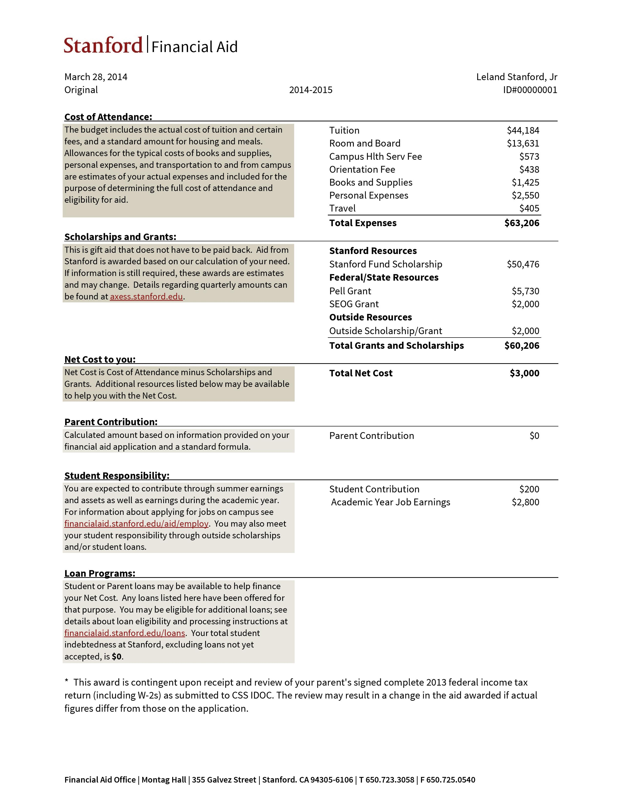
Notes:
Lower down, they explain they expect you to meet the $3,000 from work.
Some don’t list non-billable costs, so be careful when comparing!

Slide 20
Review questions:
How much does Stanford cost?
How much does Leland have to pay?
How much money does Leland have to pay back eventually?
New questions:
What will Leland have to pay to the school right away?
What other money will he need right away?
Notes:
Lower down, they explain they expect you to meet the $3,000 from work.
Some don’t list non-billable costs, so be careful when comparing!

Slide 21
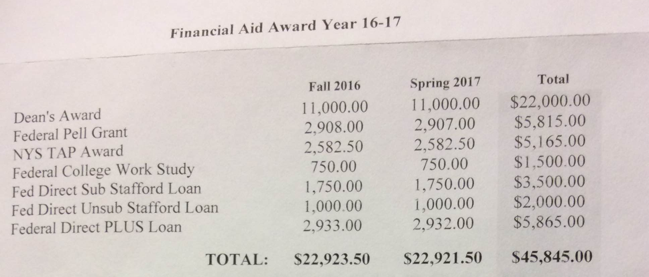

Slide 22
What other information do we need to evaluate this financial aid package?
How much of this money does this person have to pay back eventually?
What money do they get up front?
Notes:
Grants: 22000+5815+5265 =231080
Loans: 3500+2000+5865 = 12365
What else is here? Work-Study – have to earn this money?

Slide 23
In some cases, you can negotiate aid
Talk to us if you want to try.
Best chances if:
You have special circumstances they may not have accounted for
You have a better offer from a comparable institution
Your financial situation has changed since you applied (i.e. parent lost job, illness, etc.)
Outside scholarships could apply against EFC
Notes:
Warning: NPCs are inaccurate for divorced parents, owners of small businesses, or international students

Slide 24
Does a college give good financial aid?
% Need Met
on Cappex
https://www.cappex.com/colleges
List of 100% Need Met colleges: https://blog.prepscholar.com/colleges-that-offer-complete-financial-aid
Cost in your income bracket
on College Scorecard
https://collegescorecard.ed.gov
Net Price Calculator
on Google/linked from College Scorecard
Types of aid
From College Navigator
https://nces.ed.gov/collegenavigator/
Notes:
Warning: NPCs are inaccurate for divorced parents, owners of small businesses, or international students. Also weird if college doesn’t meet 100% of need.

Slide 25
Things to Remember (part 1)
Look closely at what a financial aid award offers you.
Is it being too optimistic? Giving merit scholarships? Giving you lots of loans? Ignoring non-billable expenses?
Make sure likely schools are also financial safety schools.

Slide 26
Things to Remember (part 2)
You may need a deposit in May or June to save your spot; start saving in January
If you qualify for fee waivers, there is a chance that this deposit can be reduced or waived
Apply early!
FSEOG or work-study money can run out
College money can run out
Definitely don’t miss the deadline!

Slide 27
Common mistake alert!
Seriously, don’t miss the deadline

Slide 28
Things to Remember (part 3)
Programs within schools might increase your eligibility for aid (more on this later):
HEOP/EOP
CSTEP
Honors college
Others
NYS STEM Incentive Program (free SUNY tuition)
Notes:
STEM Incentive Program: free SUNY tuition if you agree to stay in NY in a STEM profession for five years after graduation

Slide 29
Info for undocumented students
You are not eligible for federal aid
SUNY and CUNY gives in-state tuition
CUNY especially has some aid put aside specifically for undocumented students
New York State DREAM Act offers an application for scholarships for NYS schools
Look for schools that will treat you as a domestic student or schools that really want you --- there are a lot!

Slide 30
What about outside scholarships?
BIG outside scholarships can be great: they can totally pay for college
…but they’re really hard to get.
Small outside scholarships
Thing carefully about amount of work vs amount you get
Check whether you’ll lose some of your school aid if you get an outside scholarship!
What strings are attached: only for one year or GPA requirement or a certain major
Notes:
You might be surprised we haven’t talked about these yet…

Slide 31
Excelsior Scholarship
Can only use at SUNYs and CUNYs
Only pays for tuition (after Pell/TAP)
Doesn’t change the circumstances for low-income families (full Pell and TAP)
Required to live in NYS

Slide 32
Most things have fees…
SAT/ACT/SAT Subject Test
Common Application
Applying to other Colleges
CSS Profile
… but these things mostly also have fee waivers.
Talk to BEAM if you think you can’t get a fee waiver.
Notes:
Irony of CSS Profile

Slide 33
Merit Aid
Different at each place:
Sometimes automatic, sometimes you apply for it
Sometimes replaces loans or work-study, sometimes makes total amount owed less
Top colleges don’t do it
Watch out for GPA requirements!
Notes:
Some of you have gone to competitive high schools; you know how your GPA takes a hit.

Slide 34
Questions?

